Slide 1



SMALL SCHOOL, BIG IMPACT
Collegiate Athlete Outcomes at Minnehaha Academy
Emily Kennett
Colorado State University Global
MIS581: Capstone - Business Intelligence and Data Analytics
Orenthio Goodwin
November 2, 2025
Notes:
Hi, my name is Emily Kennett, and I am excited to share the results of my Capstone project, “Small School, Big Impact: Collegiate Athlete Outcomes at Minnehaha Academy.”
My goal today is to review data-driven insights explaining why Minnehaha Academy athletes advance to collegiate athletics at more than twice the national rate and to identify what specific student and institutional factors drive that success.
I will walk you through my methods, findings, and actionable recommendations that can inform future athletic programming, marketing, and student-support strategies.

Slide 2
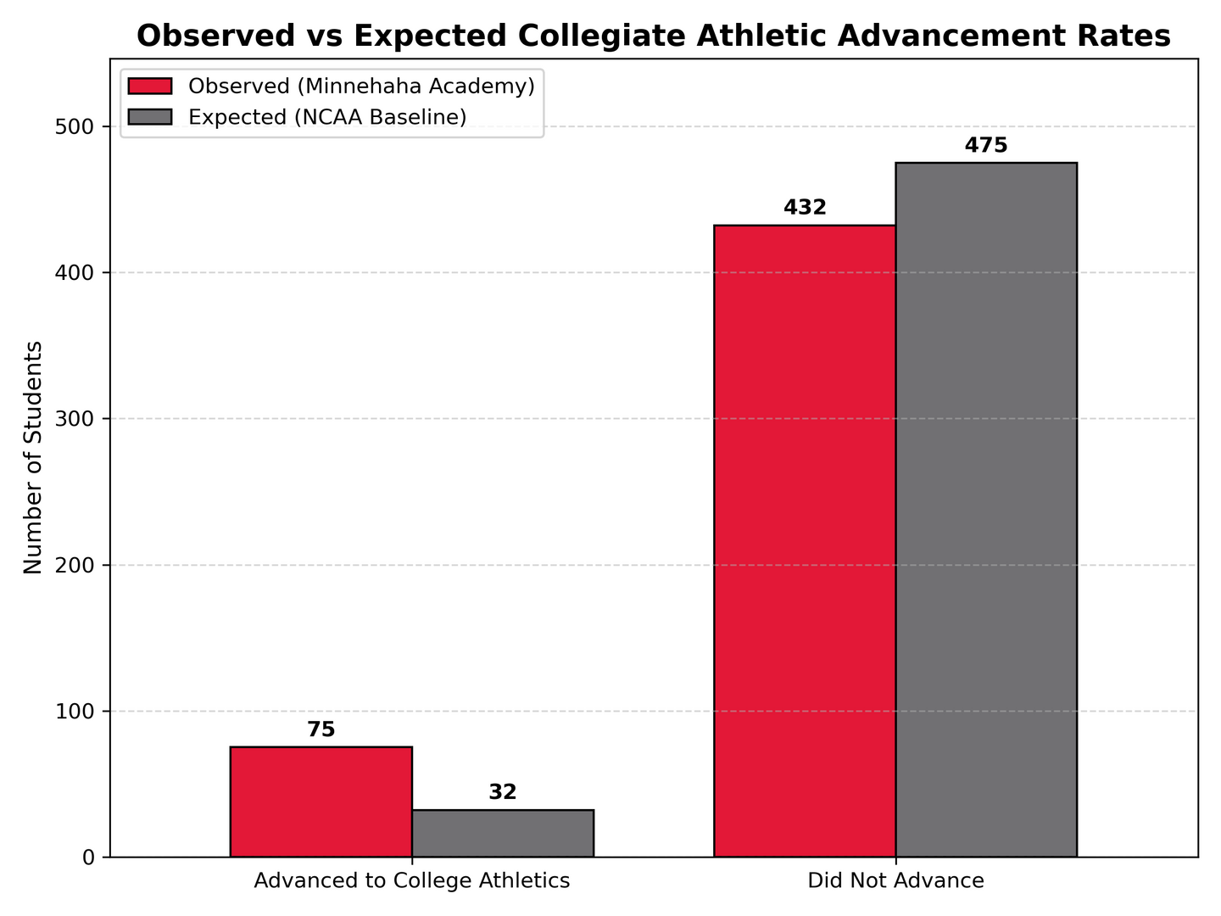
PROBLEM & PURPOSE
National Advancement Rate: 6.3%
(2% at DI level)
Minnehaha Advancement Rate: 14.8%
(6.3% at DI level)
Purpose:
Examine why Minnehaha athletes advance at 2x the national rate
Identify predictors that explain this success
Figure 1: Observed vs. Expected Advancement Rates
(NCAA, 2024)
Notes:
National data from the NCAA show that only 6.3% of high school athletes compete in college, and only 2% reach Division I levels.
At Minnehaha Academy, however, 14.8% of student-athletes advance to college competition (over twice the national rate) and 6.3% of them compete at the Division I level.
This prompted my key question: What makes Minnehaha different?
The purpose of this study was to identify the academic, athletic, and behavioral characteristics that explain this exceptional success rate and to determine how these insights can guide institutional planning and resource allocation moving forward.

Slide 3

RESEARCH QUESTIONS
AND APPROACH
Do Minnehaha athletes advance to college sports at higher rates than the national average?
RQ1
Which student factors best predict athletic advancement?
RQ2
Methods Used:
Descriptive: Chi-square and z-tests
Predictive: Logistic regression, decision tree, random forest, gradient boosting
(Maguire, 2018)
Notes:
The study was guided by two primary questions:
Do Minnehaha athletes advance at significantly higher rates than national averages?
Which measurable student characteristics best predict collegiate advancement?
I used a combination of descriptive and predictive analytics:
Descriptive: Chi-square and z-tests compared Minnehaha’s advancement rates to national benchmarks.
Predictive: Logistic regression, decision tree, random forest, and gradient-boosted models identified the top predictors of advancement.
This hybrid quantitative approach provided both statistical significance and interpretability for leadership decision-making.

Slide 4
DATASET OVERVIEW
Sports &
Fine Arts
Sports Count
Gender
GPA
ATHLETIC
Race
Graduate Status
Years as Athlete
ACADEMIC
DEMOGRAPHIC
Sports
Financial Aid
Absence %
Region
Tardiness
Notes:
My dataset included five years of de-identified student-athlete records (2020–2025).
Data fields represented three core domains:
Academic: GPA, absences, tardiness, and graduation status
Athletic: number of sports played, fine arts participation, years active
Demographic: gender, race, region, and financial aid indicators
An important distinction is that these data represent a population census of all student-athletes during the period, not a sample, meaning my findings reflect complete institutional performance, not estimates.
Data cleaning, validation, and aggregation ensured integrity, FERPA compliance, and reliability in predictive modeling

Slide 5
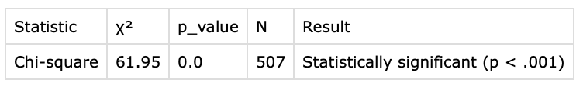
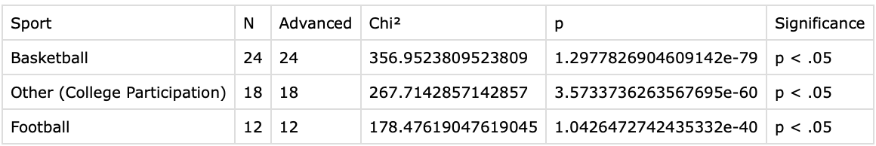
RQ1 RESULTS: ADVANCEMENT RATES
Figure 2: Chi-Square Results for Advancement Rates Comparison (All Sports)
Figure 3: Chi-Square Results for Advancement Rates Comparison (Significant Sports)
Conclusion: Minnehaha athletes advance at significantly higher rates.
Notes:
A chi-square test confirmed a statistically significant difference in advancement rates between Minnehaha Academy and national NCAA data χ²(1, N = 507) = 61.95, p < .001 (A chi-square test with one degree of freedom and a sample size of five hundred seven yielded a value of sixty-one point nine-five, with a p-value less than point zero-zero-one, indicating a statistically significant difference.)
Our athletes advance at 14.8% compared to the 6.3% national average, meaning Minnehaha students are more than twice as likely to compete at the collegiate level.
To understand which sports drove this difference, I conducted z-tests for proportions across seven sports compared to NCAA baselines.
Basketball (z = 6.81, p < .001) and football (z = 3.36, p < .001) showed significantly higher advancement rates.
Volleyball (z = 2.36, p = .018) also trended higher, though it did not remain significant after Bonferroni correction.
Other sports such as cross country, soccer, and track were consistent with national averages.
The “Other” category (smaller sports with ≤5 athletes advancing) had a higher rate (z = 2.64, p = .008), though results should be interpreted cautiously due to small sample sizes.
This analysis highlights that Minnehaha’s strongest programs, particularly basketball and football, substantially elevate the school’s overall advancement rate. However, the balance across other sports suggests systemic strength rather than isolated excellence, a key finding that supports continued investment across multiple athletic programs.

Slide 6
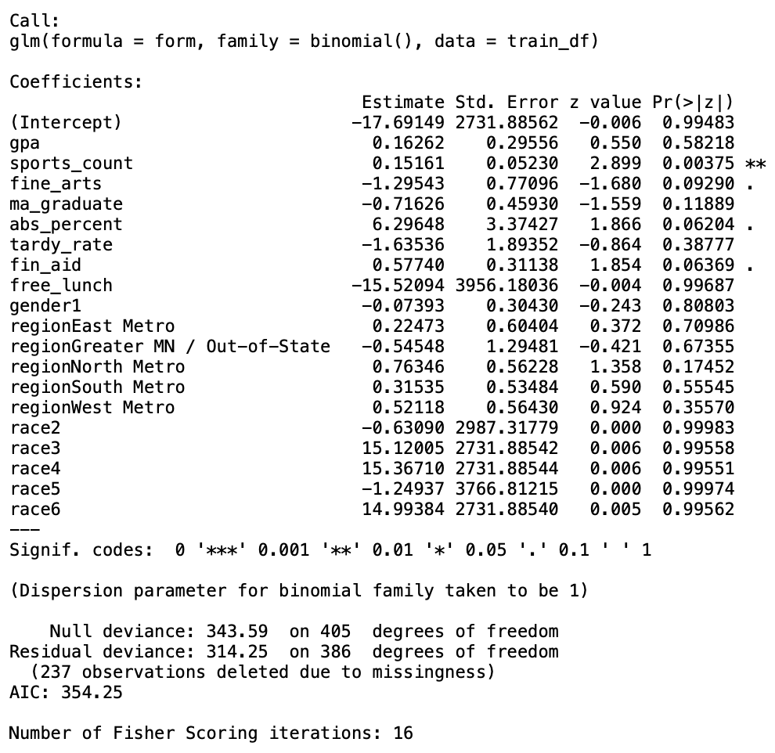
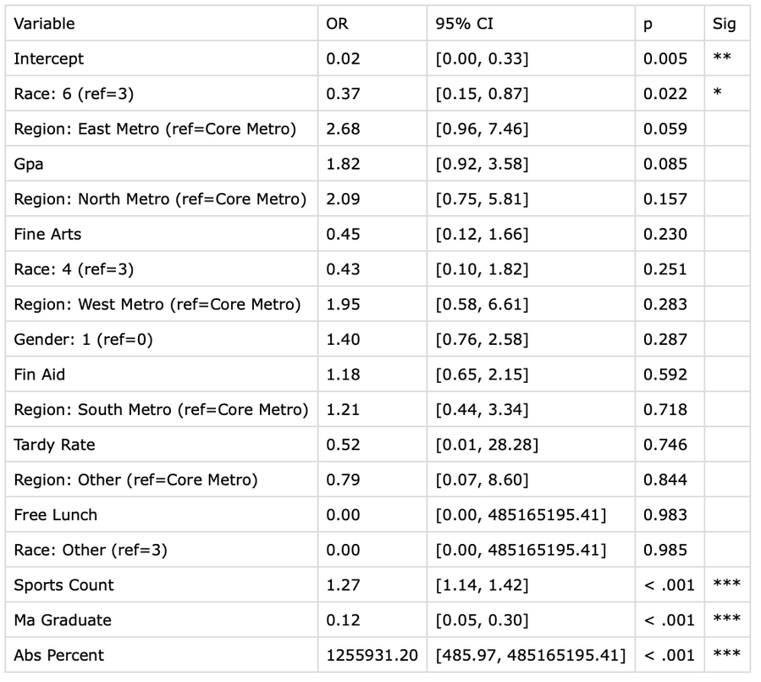
RQ2 RESULTS:
TOP PREDICTORS
Figure 4: Odds Ratios
Figure 5: Logistic Regression Summary
Notes:
My predictive models identified the strongest, most consistent drivers of collegiate advancement.
Across logistic regression, random forest, and gradient boosting, participating in multiple sports (sport count) was the most influential variable, increasing odds of advancement by about 27% per additional sport played.
Absence percentage also correlated positively, reflecting excused athletic travel rather than disengagement.
Across all models, the same variables consistently ranked as top predictors:
Graduation Status
Sports Count
GPA
Absence Percentage
Tardy Rate
This consistency across models builds strong confidence that these are the true drivers of advancement. It also demonstrates that Minnehaha’s holistic approach (where academics and athletics reinforce one another) produces measurable results.
The takeaway for leadership is clear: sustained enrollment through graduation, balanced athletic participation, and strong academic engagement together create the optimal conditions for student-athlete success. These findings validate the school’s current structure and offer a quantitative foundation for future resource decisions.

Slide 7
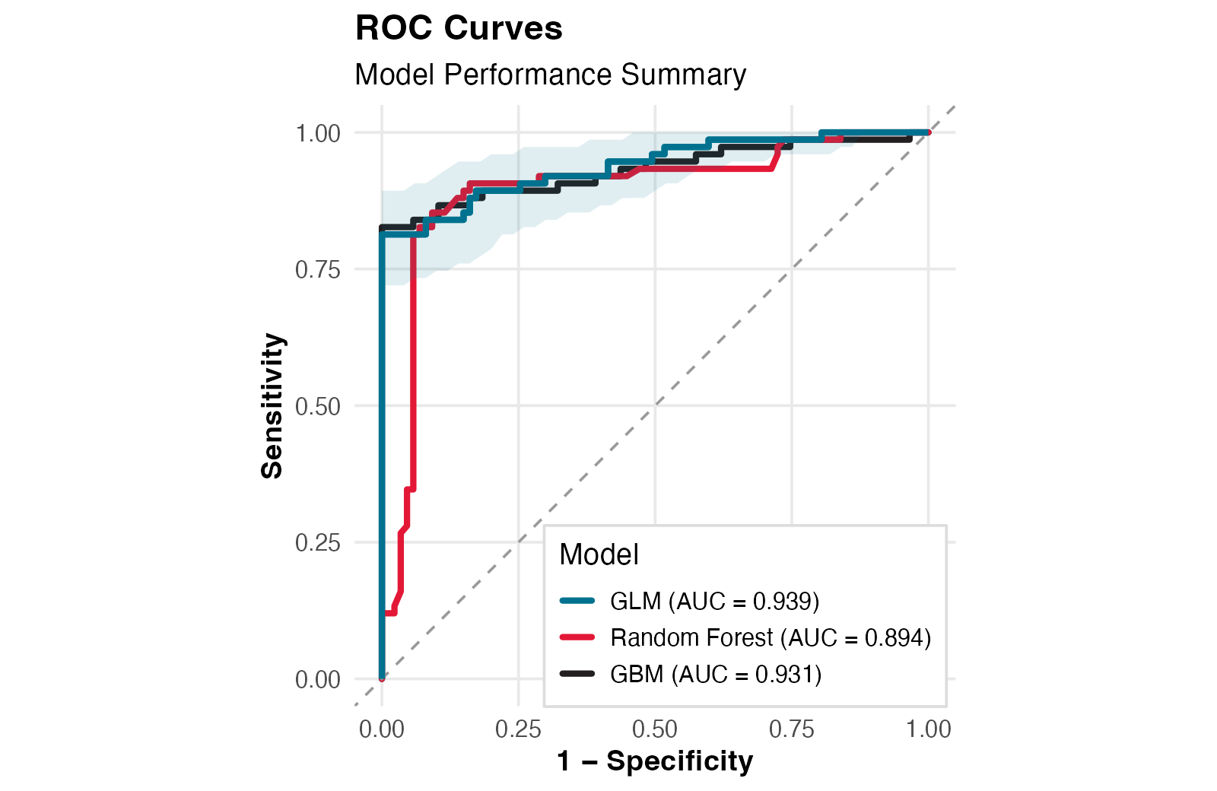
MODEL
PERFORMANCE
Logistic Regression
Accuracy: .91
ROC AUC: .94
Random Forest
Accuracy: .88
ROC AUC: .90
Gradient Boost
Accuracy: .88
ROC AUC: .90
Figure 6: Model Performance Summary (ROC Curves)
Notes:
To ensure the robustness of results, we compared multiple models: logistic regression, random forest, and gradient boost. Across all models, sports count, absence percentage, GPA, and graduation status consistently emerged as the strongest predictors. The high AUC values (above .90) confirm that our models achieved strong predictive power, meaning these insights can be used confidently for future forecasting and student-support interventions.

Slide 8
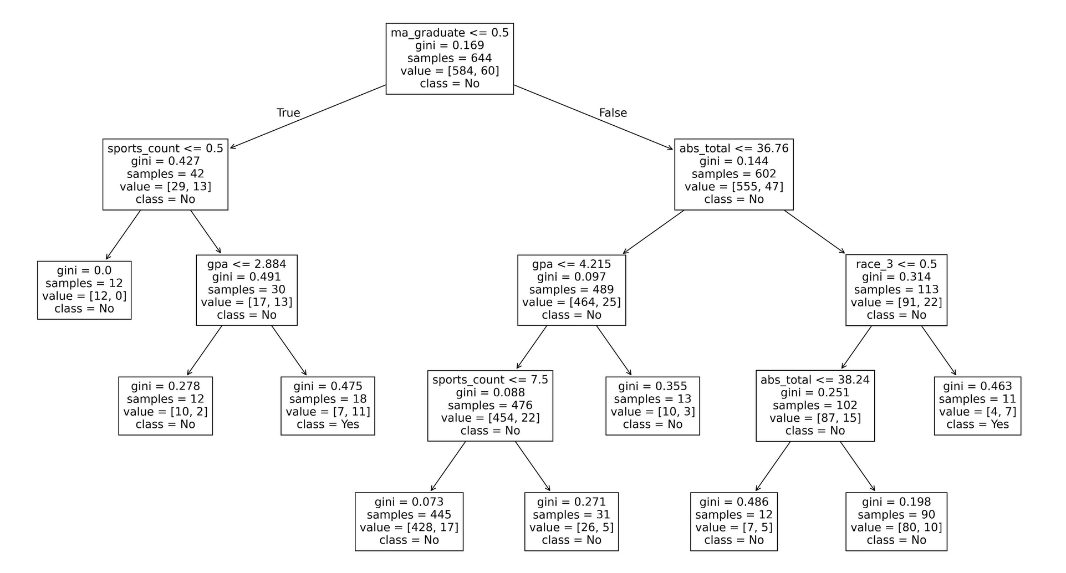
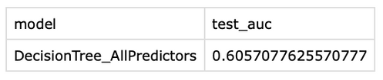
DECISION TREE
Figure 7: Decision Tree
Notes:
The decision tree visualization provides an intuitive view of how these factors interact.
The first split occurred on Minnehaha graduation status.
Among graduates, lower absence percentages and higher GPAs predicted advancement.
Among transfer students, multi-sport participation and GPA above 2.88 were most predictive.
This model demonstrates that different pathways can lead to success; both academic consistency and diverse athletic engagement foster advancement potential.
For leadership, this emphasizes the need for programming that maintains engagement and retention, helping student-athletes build sustained momentum through graduation rather than fragmenting their experiences across multiple schools.

Slide 9
IMPLICATIONS & RECOMMENDATIONS
Encourage multi-sport participation
Differentiate Athletic vs Academic Absences
Integrate Academic and Athletic Counseling
Highlight Institutional Success in Marketing & Development
Expand Data Collection and Predictive Monitoring
Complement Quantitative Findings with Qualitative Insights
Strengthen Retention Supports for Student Athletes
(Broh, 2002; Johnson, 2023; Kohl, 2017; Maguire, 2018; Ryan et al., 2007; Shifrer et al., 2015; Tompsett & Knoester; 2021)
Notes:
Based on these findings, several strategic recommendations emerge for Minnehaha Academy’s leadership:
First, encourage multi-sport participation. My findings confirm that students who play multiple sports are more likely to advance, supporting continued emphasis on athletic diversity over specialization.
Second, differentiate athletic versus academic absences. Creating separate tracking codes will ensure travel-related absences are recorded accurately and not misinterpreted as disengagement.
Third, integrate academic and athletic counseling. Coordinated advising can help student-athletes maintain academic performance while pursuing athletic goals.
Fourth, highlight institutional success in marketing and development. The verified 14.8% advancement rate is a powerful message for recruitment, alumni engagement, and donor relations.
Fifth, expand data collection and predictive monitoring. Adding variables such as socioeconomic indicators or club-level participation will improve future forecasting and planning.
Sixth, complement quantitative findings with qualitative insights. Interviews with athletes and coaches can capture motivation, culture, and experiences behind the data.
Finally, strengthen retention supports for student-athletes. Since graduation status was a top predictor of advancement, reinforcing engagement and support through senior year will ensure more students complete their athletic and academic journeys at Minnehaha.
Together, these steps sustain the school’s momentum and reinforce its position as a model of balanced academic and athletic excellence.

Slide 10
REFERENCES
Broh, B. A. (2002). Linking extracurricular programming to Academic Achievement: Who benefits and why? Sociology of Education, 75(1), 69. https://doi.org/10.2307/3090254
Johnson, J. (2023). The effect of athletic participation on academic achievement for private high school students [Doctoral dissertation, Lynn University]. SPIRAL. https://spiral.lynn.edu/etds/398
Kohl, C. J. (2017). The academic and behavioral impact of multiple sport participation on high school athletes [Doctoral dissertation, Lindenwood University]. Digital Commons. https://digitalcommons.lindenwood.edu/dissertations/199
Maguire, A. J. (2018). High school interscholastic athletic participation influence on student educational outcomes: a retrospective mixed-methods analysis of the high school interscholastic athletic experiences of undergraduate college students [Doctoral dissertation, The George Washington University].
NCAA. (2024). Estimated probability of competing in college athletics. https://ncaaorg.s3.amazonaws.com/research/pro_beyond/2023RES_ProbabilityBeyondHSFiguresMethod.pdf
Ryan, C. J., Groves, D., & Schneider, R. (2007). A Study of Factors that Influence High School Athletes to Choose a College or University, and a Model for the Development of Player Decisions. College Student Journal, 41(3), 532–539. https://eric.ed.gov/?id=EJ777962
Shifrer, D., Pearson, J., Muller, C., & Wilkinson, L. (2012). College-Going benefits of high school sports participation. Youth & Society, 47(3), 295–318. https://doi.org/10.1177/0044118x12461656
Tompsett, J., & Knoester, C. (2021). The making of a college athlete: high school experiences, socioeconomic advantages, and the likelihood of playing college sports. Sociology of Sport Journal, 39(2), 129–140. https://doi.org/10.1123/ssj.2020-0142
Notes:
References include peer-reviewed and data-based sources that informed both the statistical framework and the interpretation of results, including:
Broh (2002), Johnson (2023), Kohl (2017), Maguire (2018), Ryan et al. (2007), Shifrer et al. (2015), Tompsett & Knoester (2021), NFHS (2021-2025), and NCAA (2024).
Together, these sources ground the project in evidence-based educational and athletic research, meeting CSU Global’s academic rigor requirements and ensuring my recommendations have additional support from past studies.

